Slide 1
Lecture 5 Inferring transmission dynamics from seroprevalence data
May 23rd, 2025
Seroanalytics Training Blantyre, Malawi

Slide 2
Lecture Outline
Understanding what age-specific patterns of seroprevalence can tell us about past transmission
Non-endemic transmission
Timing and magnitude of past outbreaks
Endemic transmission
Force of infection

Slide 3
Population transmission dynamics
How has the pathogen spread in a given population?

Slide 4
Population transmission dynamics
How has the pathogen spread in a given population
Endemic
Sustained/persistent transmission
Can have epidemic or seasonal cycles
Non-Endemic
Sporadic outbreaks
Transmission is not continuous

Slide 5
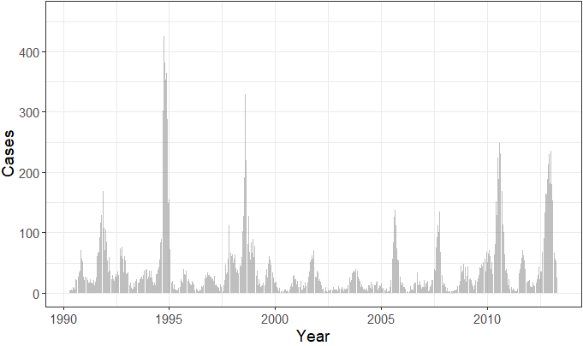
Population transmission dynamics
Endemic
Sustained/persistent transmission
Can have epidemic or seasonal cycles
Reported dengue cases in Brazil

Slide 6
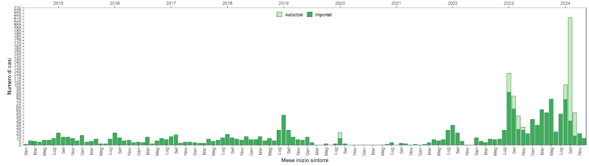
Population transmission dynamics
Non-Endemic
Sporadic outbreaks
Transmission is not continuous
Reported dengue cases in Italy
Notes:
A majority of cases are imported (dark green). Source: https://www.epicentro.iss.it/arbovirosi/dashboard

Slide 7
Why is this useful?
Many infections can be missed by disease surveillance systems
Asymptomatic and mild infections
To understand when in the past these infections occurred
Quantifying annual risks of infection or average outbreak size
Valuable for planning control & prevention efforts

Slide 8
Age = time spent at risk of infection
As we get older, we are more likely to have encountered more pathogens
Age = time spent at risk of infection
Age is therefore a proxy for time
Age-specific seroprevalence can help tell us what has happened in the past

Slide 9
When is this applicable?
i.e. when can age tell us about past transmission
When seroprevalence ≈ ever infected
Pathogen:
Must be a pathogen that induces long-term antibody response
Antibody isotype:
IgG (longest-lived isotype)
Study type:
Cross-sectional seroprevalence studies
One time-point, single sample per person
Sometimes, data from cohort or other studies can be used
E.g. the first sample from each participant (if taken around the same timeframe)
Notes:
The methods discussed in this lecture will assume lifetime persistence of IgG antibodies after infection

Slide 10



Example
<5 years
≥5 years
Seroprevalence=0%
Seroprevalence=30%

Slide 11
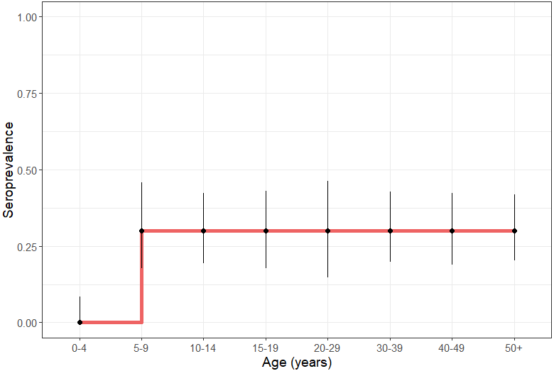
Example
<5 years old
≥ 5 years old
Seroprevalence=0%
Seroprevalence=30%
What kind of transmission has happened here?

Slide 12
Example
Non-endemic transmission
0% seroprevalence in children aged 0-4 means the pathogen has not transmitted in the past 4 years
An equal infection attack rate among those ≥ 5 years suggests:
An outbreak occurred ~ 5 years ago
30% infection attack rate

Slide 13
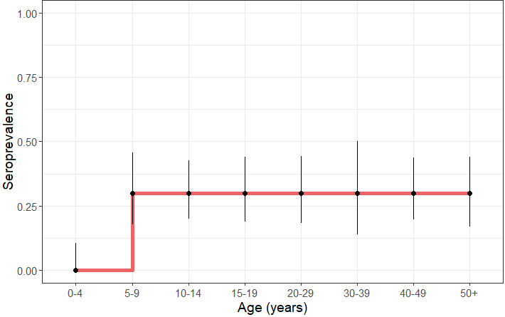
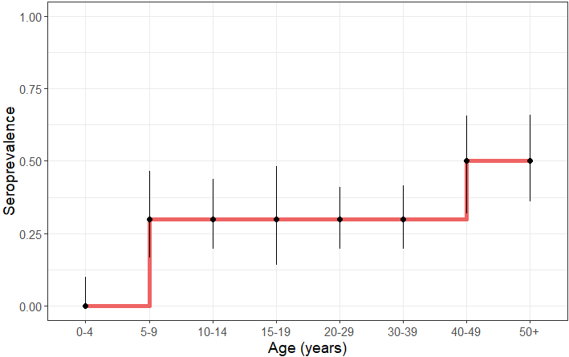
Non-endemic transmission
Flat age-specific seroprevalence profiles
Everyone alive during an epidemic has approximately the same infection risk
The more epidemics an age-group has lived through, the higher the chance of infection

Slide 14
Non-endemic transmission
Pathogen has been absent for past 4 years (0% seroprevalence in children <5)
Participants aged 5-39 have equal attack rates
-> outbreak occurred ~ 5 years ago
-> 30% attack rate
Participants aged ≥ 40 have equal attack rates
-> outbreak occurred ~40 years ago
-> 20% attack rate
These participants were alive for 2 outbreaks (20% + 30% attack rates = 50% seroprevalence)

Slide 15
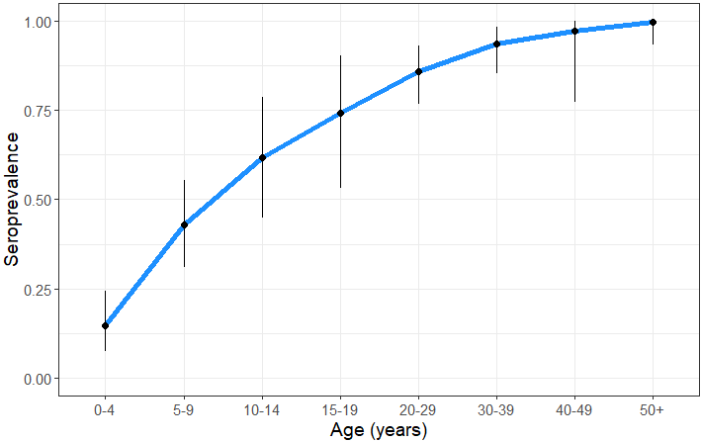
Endemic transmission
Increasing seroprevalence with increasing age
When a pathogen continuously transmits in a population, age is a direct measure of the time spent at risk of infection
Valuable to quantify the force of infection (FOI)

Slide 16
Endemic transmission: FOI
Force of infection (FOI) is also often called transmission intensity
Defined as: “Rate at which susceptible individuals become infected”
Can be estimated using a catalytic model
Fit to age-specific seroprevalence data

Slide 17
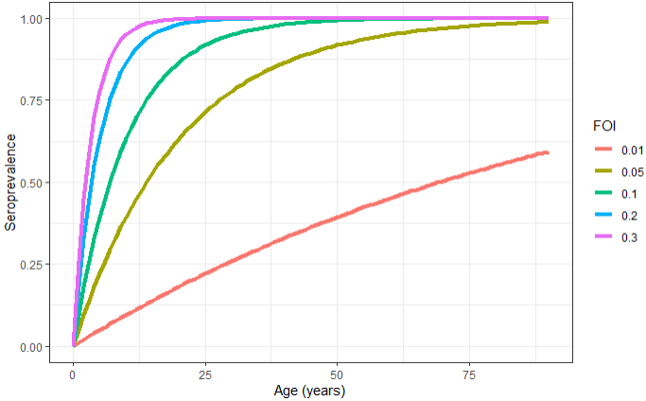
Catalytic model
ϖ_{a}= 1-exp(-λ*a)
λ = FOI
ϖ_{a} = proportion positive at age a
Assumptions:
Transmission is constant over time
Infection risk is independent of age
The cumulative risk of ever having been infected accumulates with age

Slide 18
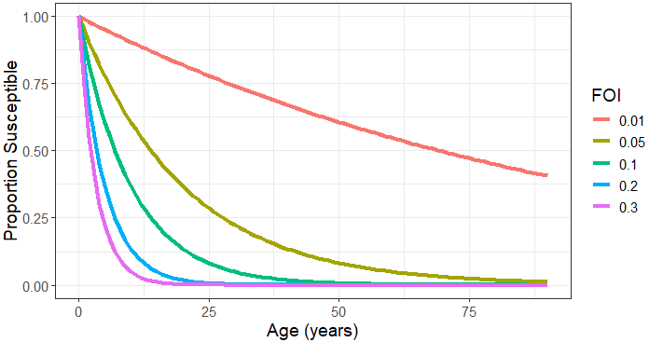
Catalytic model
ϖ_{a}= 1-exp(-λ*a)
λ = FOI
ϖ_{a} = proportion positive at age a
Susceptible_{a} = 1 - ϖ_{a}
Assumptions:
Transmission is constant over time
Infection risk is independent of age
We will implement this using a simple regression model
glm function
complementary log-log link

Slide 19
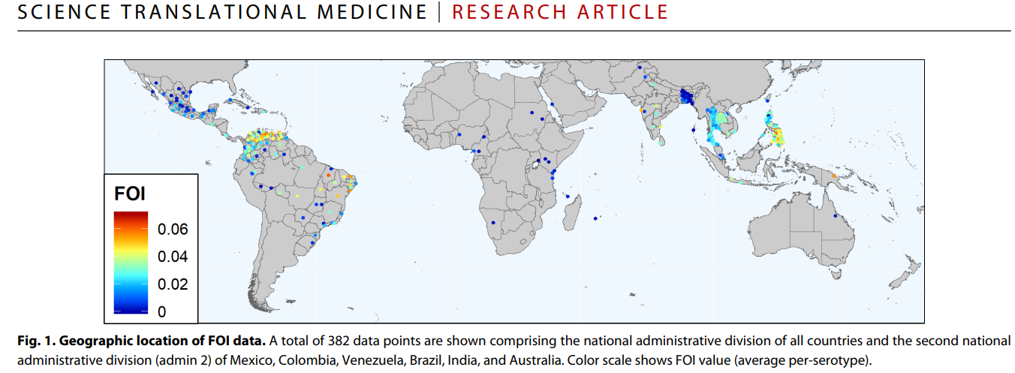
Value of FOI
Allows us to quantify the level of transmission
number of annual infections
Prioritization of vaccines and other control strategies
Catterino et al., Science Translational Medicine, 2020

Slide 20
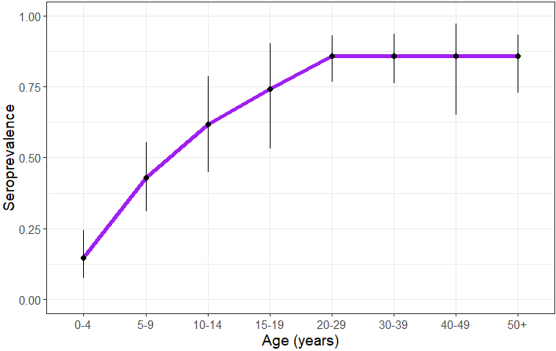
?
What kind of transmission has happened here?

Slide 21
Recently established endemic transmission
Pathogen began circulating ~20 years ago
Everyone >20 years has same attack rate
Increasing seroprevalence with increasing age in younger age groups
-> recent endemic transmission

Slide 22
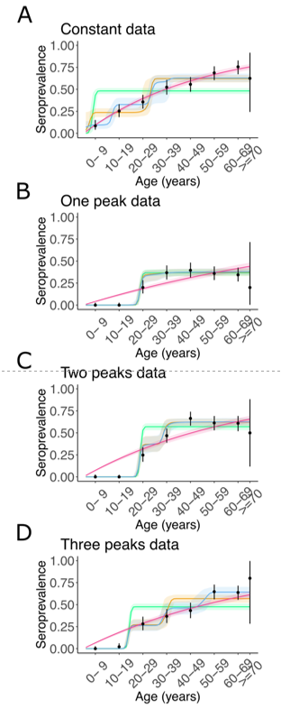

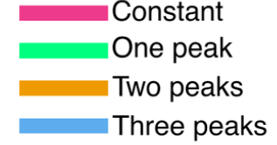
RSero: R package

Slide 23
Additional resources
RSero package for reconstructing past transmission
https://journals.plos.org/ploscompbiol/article?id=10.1371/journal.pcbi.1012777
Seroincidence estimation (pathogens that induce only short-lived antibody responses)
Cholera: https://pmc.ncbi.nlm.nih.gov/articles/PMC7738617/
Typhoid: https://pubmed.ncbi.nlm.nih.gov/35750069/
Reversible catalytic model (when antibody responses wane significantly over time)
Malaria: https://www.pnas.org/doi/10.1073/pnas.0408725102
Enteropathogens: https://elifesciences.org/articles/45594#s4
Joint fitting of mixture and catalytic models
https://journals.sagepub.com/doi/10.1177/1471082X12457495
https://journals.plos.org/plosntds/article?id=10.1371/journal.pntd.0010592

Slide 24
Conclusions
Age-specific seroprevalence data can help us reconstruct past transmission dynamics
Seroprevalence that continuously increases with age indicates endemicity
Staggered, step-wise increases in seroprevalence indicate sporadic epidemics
Understanding if a pathogen is endemic or not has important public health implications
Past infection rates can be quantified
Non-endemic settings: frequency & magnitude of outbreaks
Endemic settings: force of infection
email: megan.odriscoll@hug.ch

Slide 25
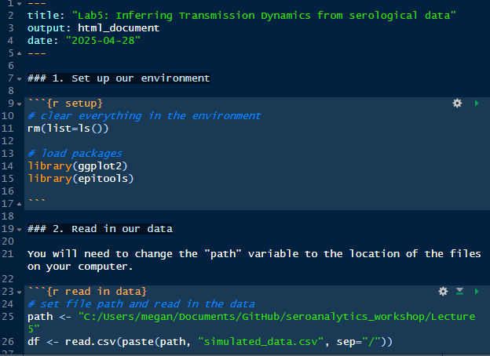
Tutorial/Lab
Calculate age-specific seroprevalence
Investigate the transmission dynamics of two pathogens
Fit a catalytic model to estimate FOI

